Slide 1

Cyber Risk from Theory to Practice

Slide 2
Jiorgos Miskakis, EvidentScientific EMEA CISO ISACA CISM,CISA,CDPSE,CRISC, PECB ISO27K Auditor&Implementer, ITIL v3
The company produces:
Microscopes
Endscopes
for industrial or health science usage

Slide 3
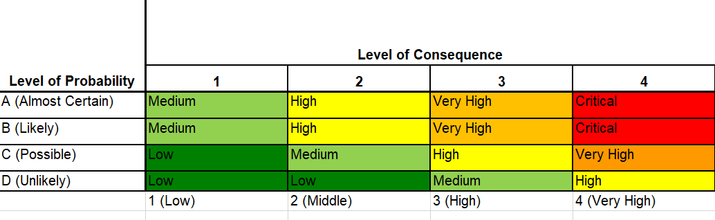
A qualitative risk assessment:
A long questionnaire with information security ISMS questions or XYZ Framework
Likelihood and Impact/Consequences are subjective given
Treatment plan includes high level statements

Slide 4




Which leads to:
Mostly to Staffing need
Questionable
Lengthy ….. discussions

Slide 5

A combined approach based on controls, efficiency and risk scenarios

Slide 6
Triage example 1
Confidentiality
5-Top Secret, e.g PII, Intellectual Property, blueprints
4-Confidential
Integrity
5-It requires the strictest controls to prevent unauthorized access, modification, or tampering
3-Data at this level is less sensitive and can tolerate a certain degree of modification or inadvertent errors. E.g build process
Availability
5-Max. 2h outage
3-Up to 8h
1-Public
1-Is not relevant, e.g synthetic random data
1-Can remain down till someone will decide otherwise
4-Max. 4h outage
2-Up to 12h

Slide 7
Triage example 2
Confidentiality
5-Top Secret, e.g PII, Intellectual Property, blueprints
4-Confidential
Integrity
5-It requires the strictest controls to prevent unauthorized access, modification, or tampering
3-Data at this level is less sensitive and can tolerate a certain degree of modification or inadvertent errors. E.g build process
Availability
5-Max. 2h outage
1-Public
1-Is not relevant, e.g synthetic random data
Distribution
5-Globally locations, multiple admins
3-Less than 3 countries, multiple users
1-Small userbase in one single country
4-Max. 4h outage
3-Up to 8h
2-Up to 12h
1-Can remain down till someone will decide otherwise

Slide 8

Framework Design Principles
Context-Based Scenarios – Tailor risks to business needs.
Asset Prioritization (Triage) – Identify and classify critical assets.
Control Mapping
Efficiency in Controls – Measurable controls (e.g., patch cadence, response time).
Risk Categorization

Slide 9
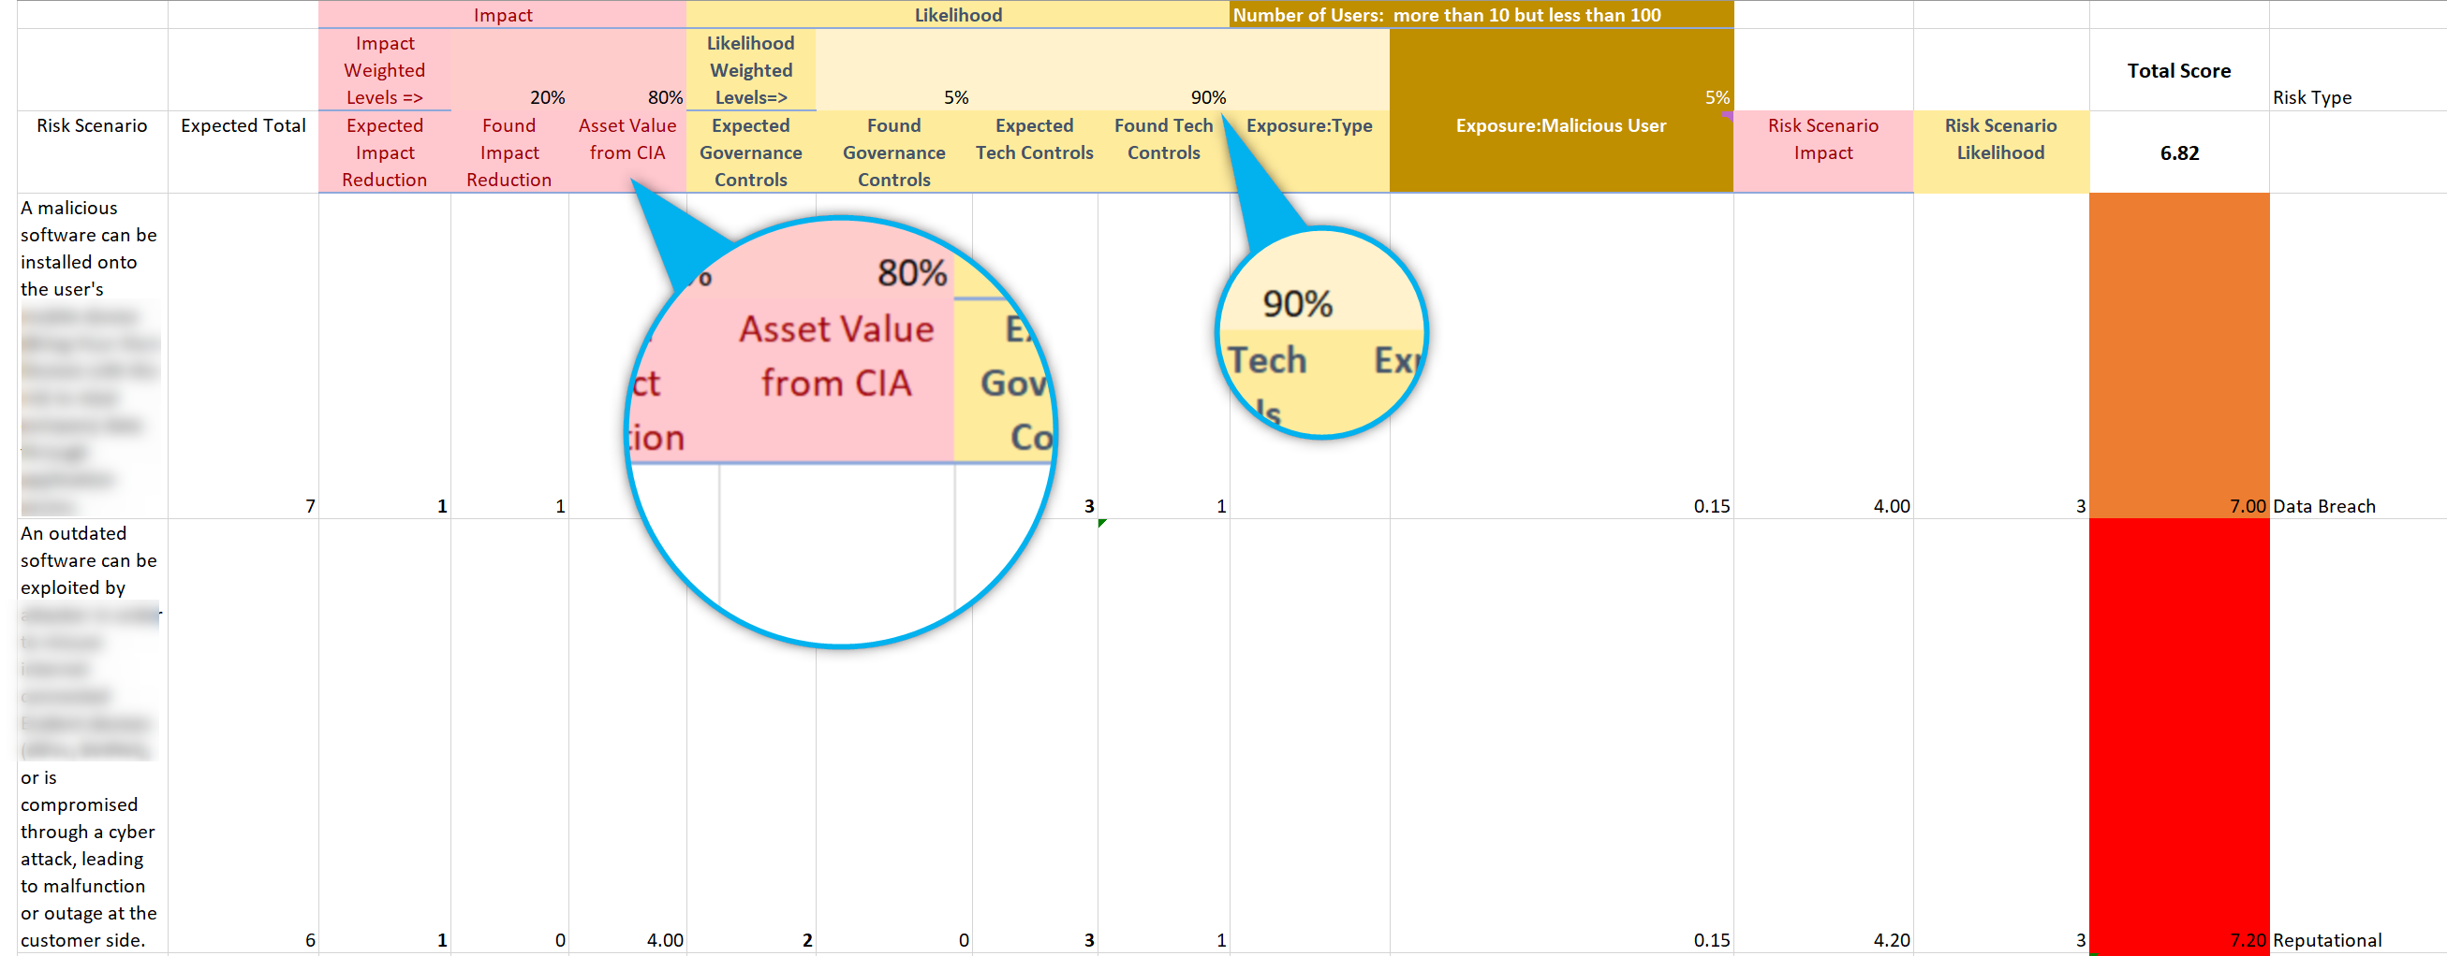
Execute (example)
Validate Scenario Relevance
Consider always the value of the asset
Governance controls can reduce the likelihood of things going wrong.

Slide 10
Key Takeaways
User-Friendly Approach – Simplifies interactions with intuitive, accessible questions
Time Considerations
Complexity Is Hidden
Broad Applicability
Tech Agnostic

Slide 11


Thank you!
Jiorgos Miskakis
https://www.linkedin.com/in/miskakis/
ISACA CISM,CISA,CDPSE,CRISC,
PECB ISO27K Auditor&Implementer,
ITIL v3

